Slide 1


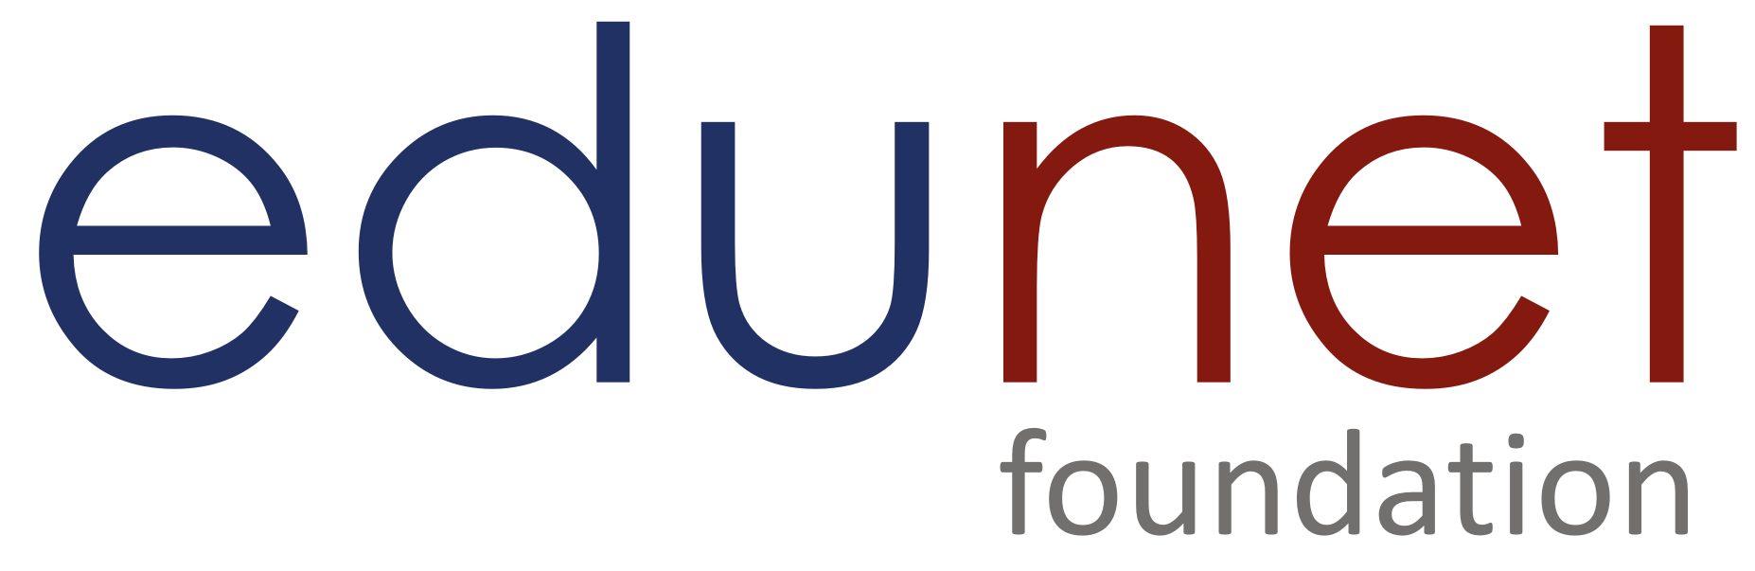

NEXT GEN EMPLOYABILITY PROGRAM
Creating a future-ready workforce
Team Members
College Name
Student Name :Anandha Eswari S
Student ID :au814721104004
SRM TRP ENGINEERING COLLEGE

Slide 2

CAPSTONE PROJECT SHOWCASE
PROJECT TITLE
Notes Sharing Web Application using Django Framework
Abstract | Problem Statement | Project Overview | Proposed Solution | Technology Used | Modelling & Results | Conclusion

Slide 3
Abstract: The project aims to develop a web application tailored for educational institutions, providing a secure platform for students and teachers to manage documents efficiently. The application features separate login portals for students and teachers, each offering distinct functionalities to cater to their needs. Students can upload assignments, access course materials, and download relevant documents, while teachers can upload lecture notes, assignments, and manage uploaded content.
Source :

Slide 4
Problem Statement: In educational institutions, there is a growing need for an efficient and secure platform that facilitates document management between students and teachers. Existing systems often lack user-friendly interfaces, robust security measures, and seamless document upload/download functionalities, leading to inefficiencies and potential privacy risks. The problem to be addressed is the absence of a comprehensive web application tailored for educational settings, where students and teachers can securely login to upload and download documents relevant to their coursework. The current manual document exchange processes are cumbersome, prone to errors, and do not provide adequate control over document access and management.
Source :

Slide 5
Project Overview The project focuses on developing a web application tailored for educational institutions to streamline document management between students and teachers. The application will provide separate login portals for students and teachers, each offering specific functionalities to cater to their roles and responsibilities. Key Features and Functionalities: User Authentication and Authorization: Students and teachers will have secure login credentials to access the platform. Role-based access control will be implemented to ensure that users can only access functionalities relevant to their roles (e.g., teachers can upload documents, students can download documents). Document Upload and Download: Teachers can upload lecture notes, assignments, and supplementary materials to the platform. Students can browse and download relevant documents for their courses. File upload functionalities will include support for various document formats and size restrictions if necessary.
Source :

Slide 6
Proposed Solution: The proposed solution aims to develop a comprehensive web application that caters to the document management needs of educational institutions. The solution will include the following key components and functionalities: User Authentication and Authorization: Implement secure login portals for students and teachers using JWT (JSON Web Tokens) for authentication. Enforce role-based access control to ensure that users can only access functionalities relevant to their roles (e.g., teachers can upload documents, students can download documents). Document Upload and Download: Teachers will have the ability to upload lecture notes, assignments, and supplementary materials through a user-friendly interface. Students can browse and download relevant documents based on their courses or subjects. Implement file upload functionalities with support for various document formats and size restrictions if necessary.
.
Source :

Slide 7
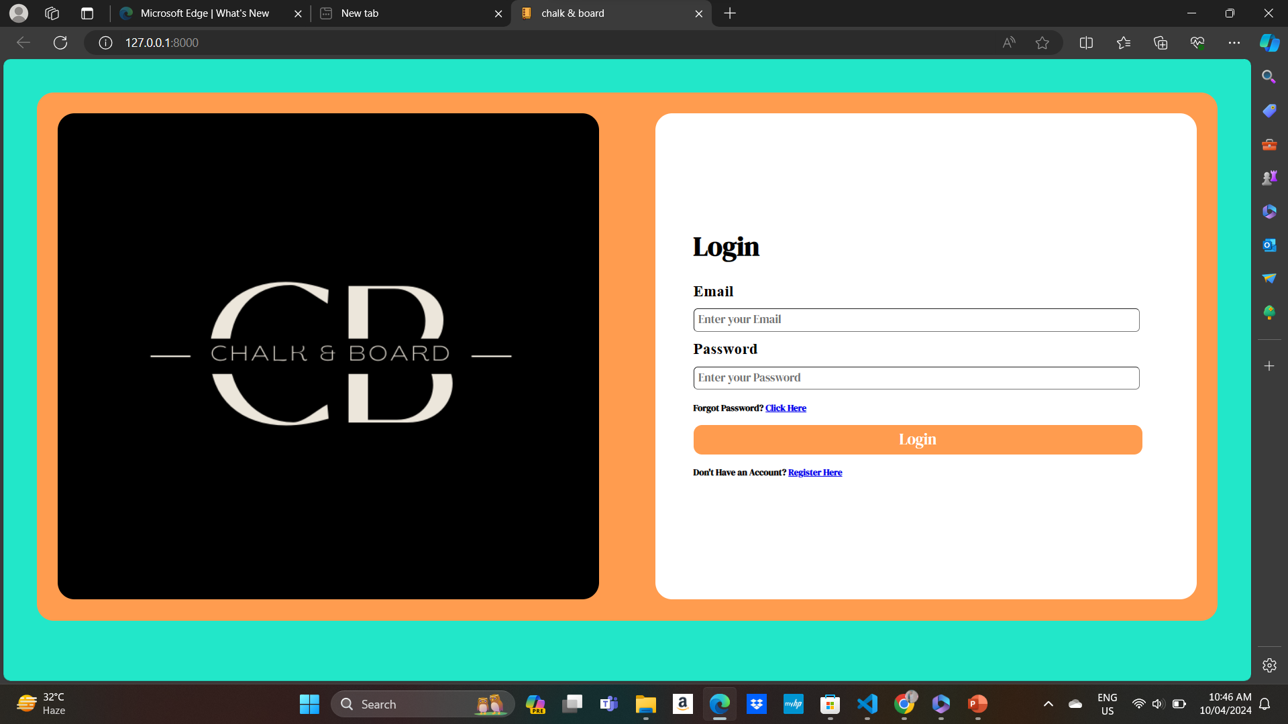
Login:

Slide 8
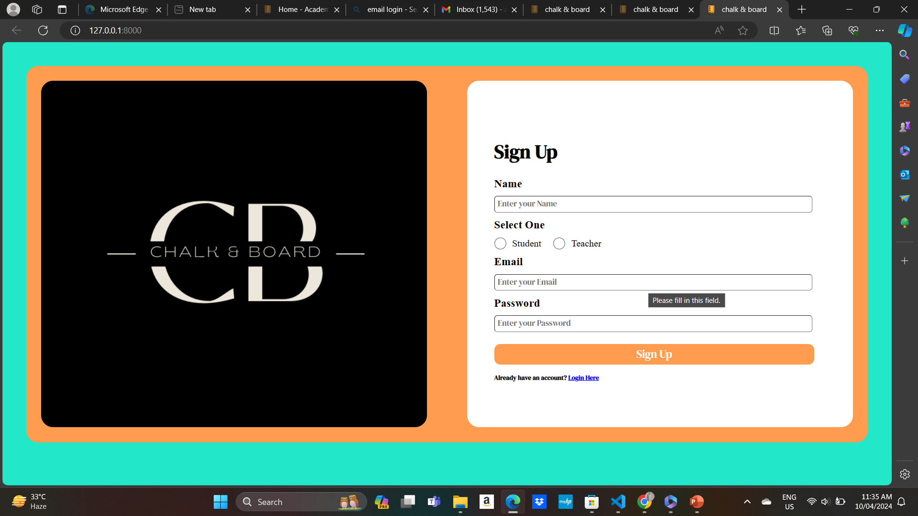
Sign Up:

Slide 9
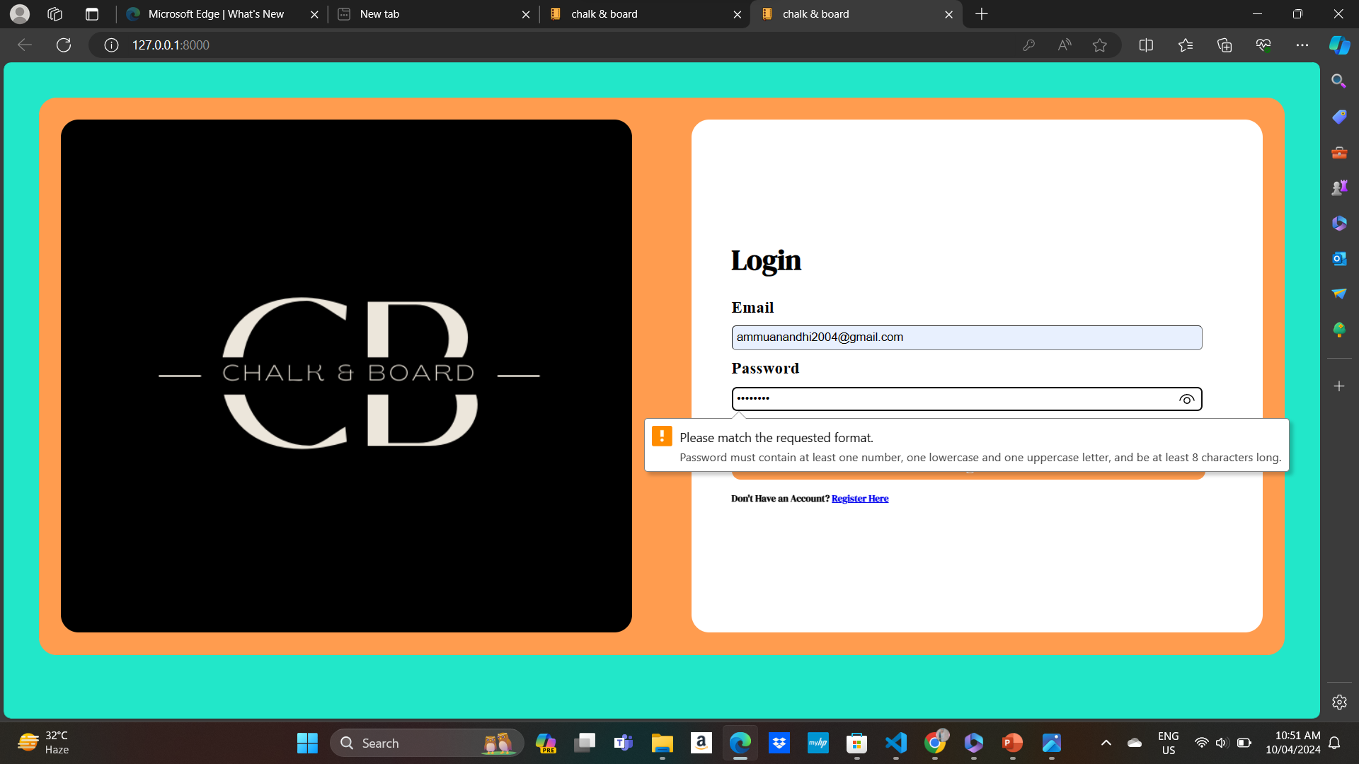
Error Notification:

Slide 10
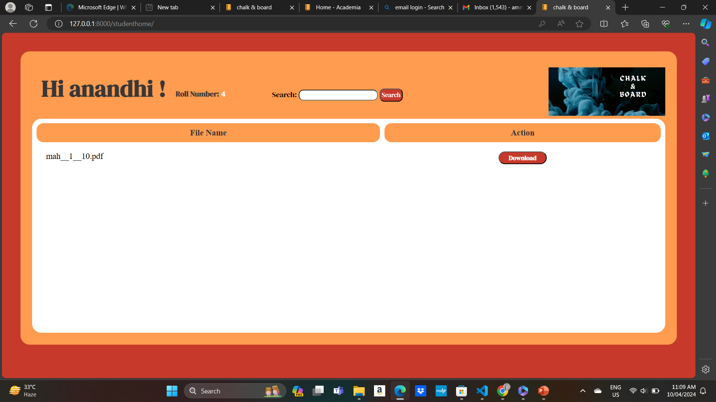
Student Login:
Source :

Slide 11
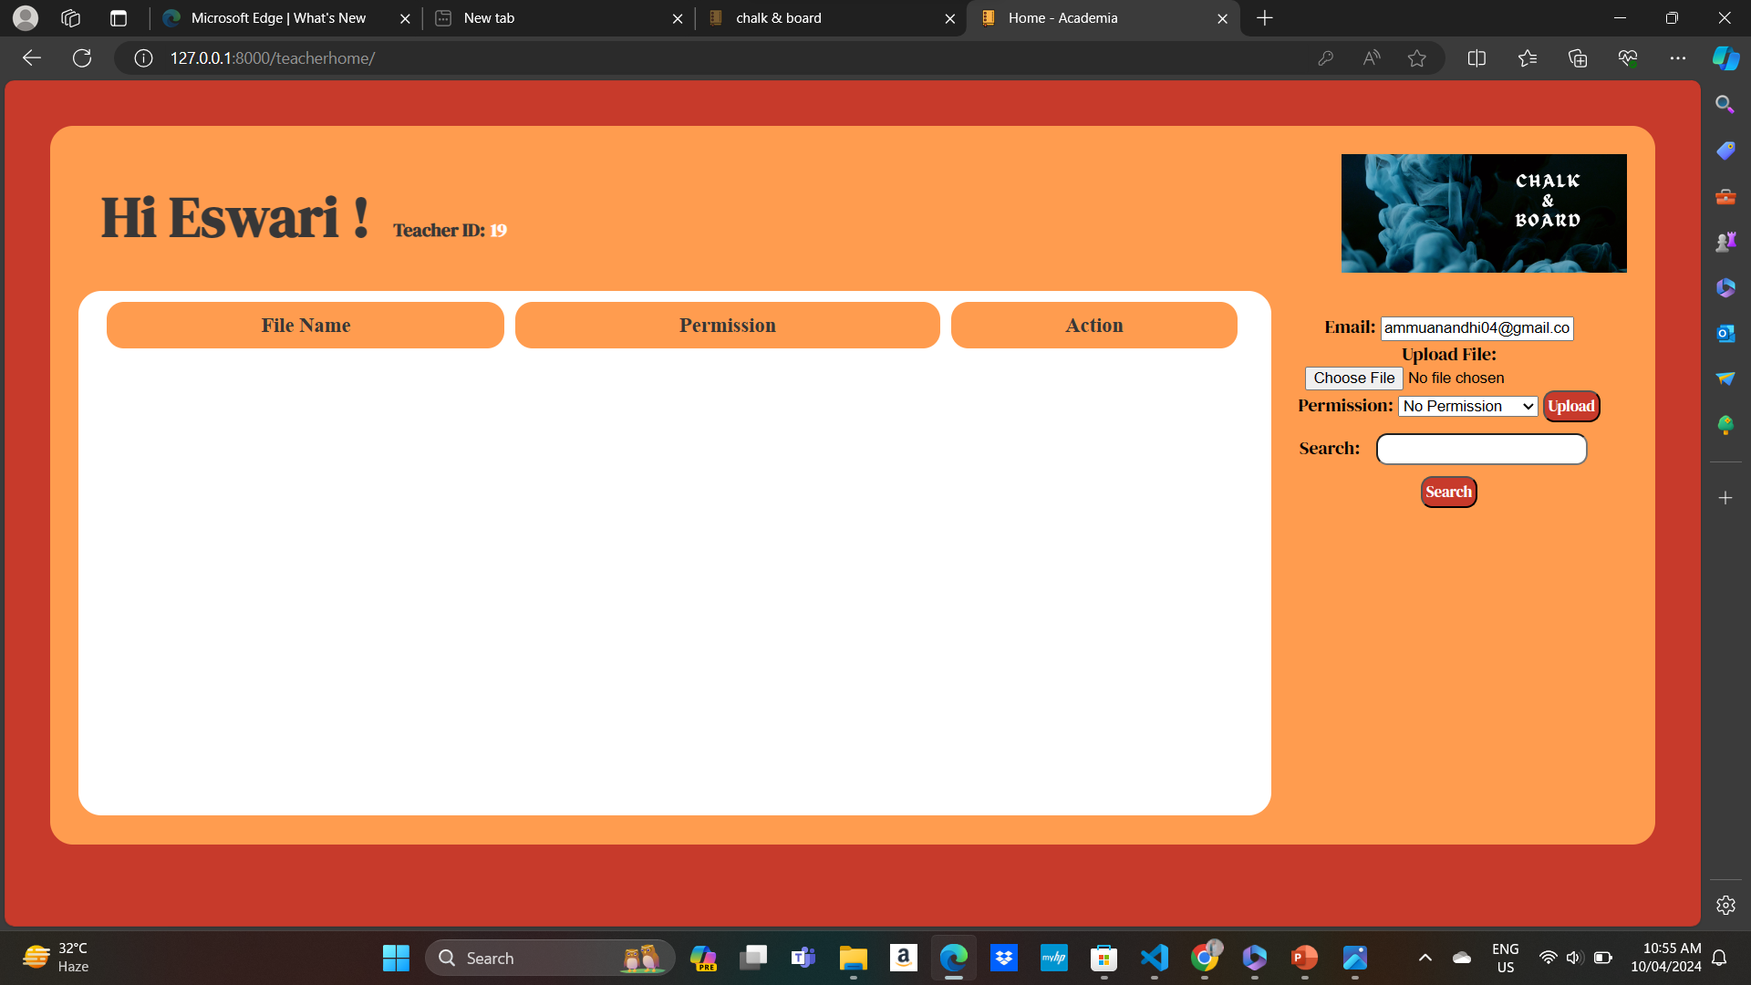
Teacher login:
Source :

Slide 12
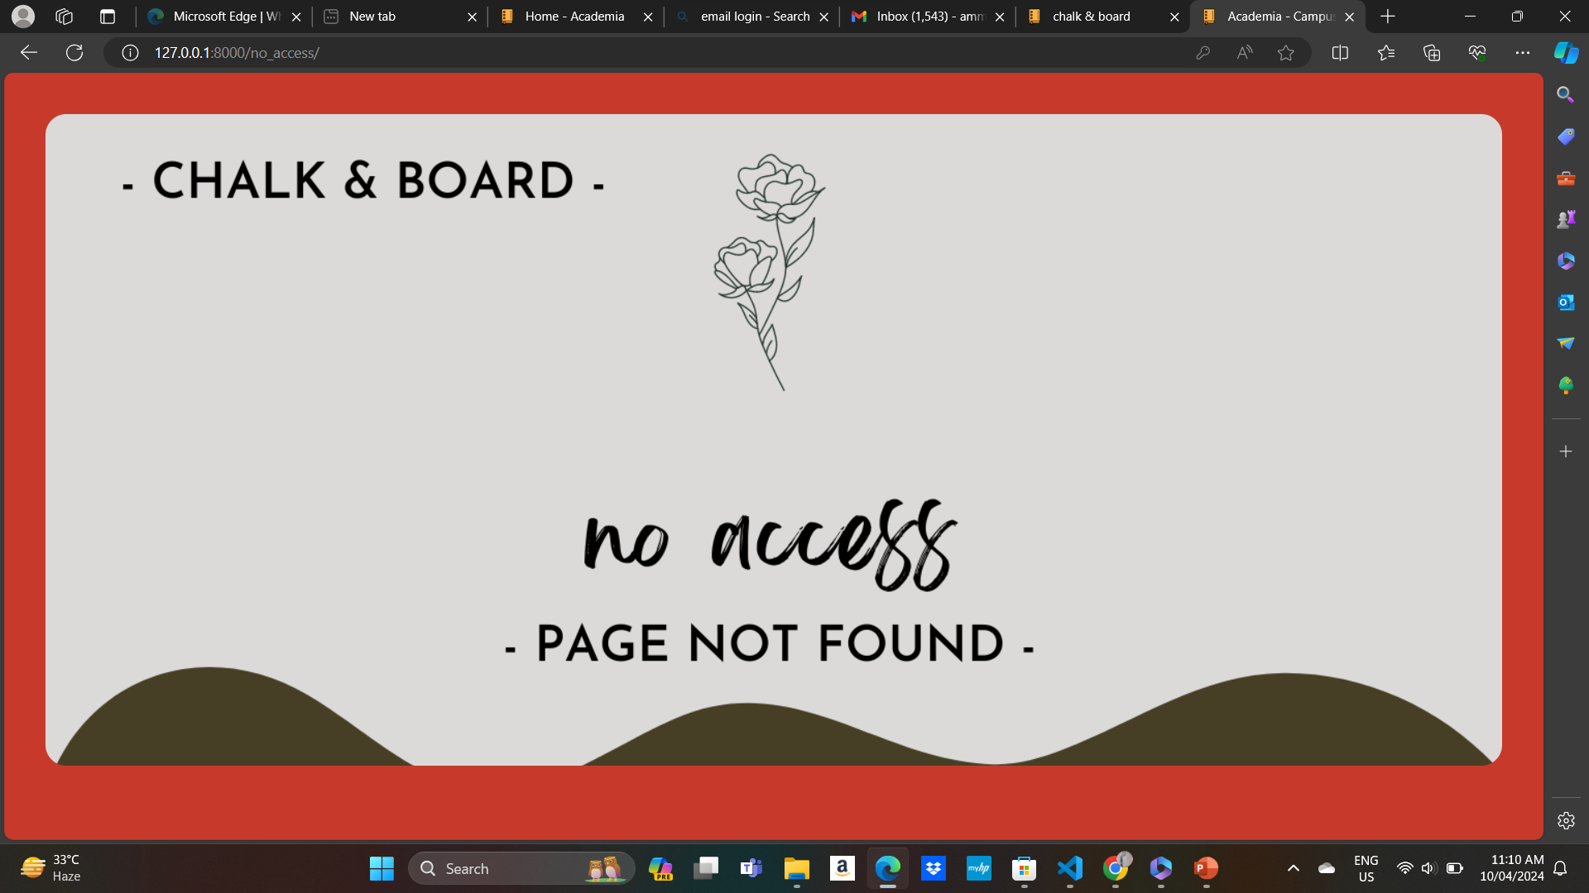
No Access:

Slide 13


Technology Used
Front-end
Back-end
Source :

Slide 14
Modelling & Results:
This website gives easier for students to get notes for studies.The notes are uploaded by the expert teachers.This website are available for everyone and is easily accessable.This results for Students can upload assignments, access course materials, and download relevant documents, while teachers can upload lecture notes, assignments, and manage uploaded content.
Source :

Slide 15
Future Enhancements:
Analytics and Reporting: Provide analytics and reporting features to track file usage, user activity, and engagement metrics.
Mobile App: Develop a mobile app for iOS and Android devices to allow users to access and share files on the go.
Enhanced Security Features: Implement additional security measures, such as encryption, to protect files and user data.
User Feedback System: Include a feedback system to gather input from users and continuously improve the application based on their suggestions.

Slide 16
Conclusion
In conclusion, the development of a web application for file sharing between students and teachers using Django offers a valuable solution to enhance collaboration and efficiency in educational settings. By providing a centralized platform for uploading, downloading, and managing files, the application streamlines the file-sharing process and improves organization.Key features such as user authentication, group management, access control, notifications, and search functionality contribute to a user-friendly experience.
Source :

Slide 17
Thank You!
Notes:
Thank You !!

